Slide 1
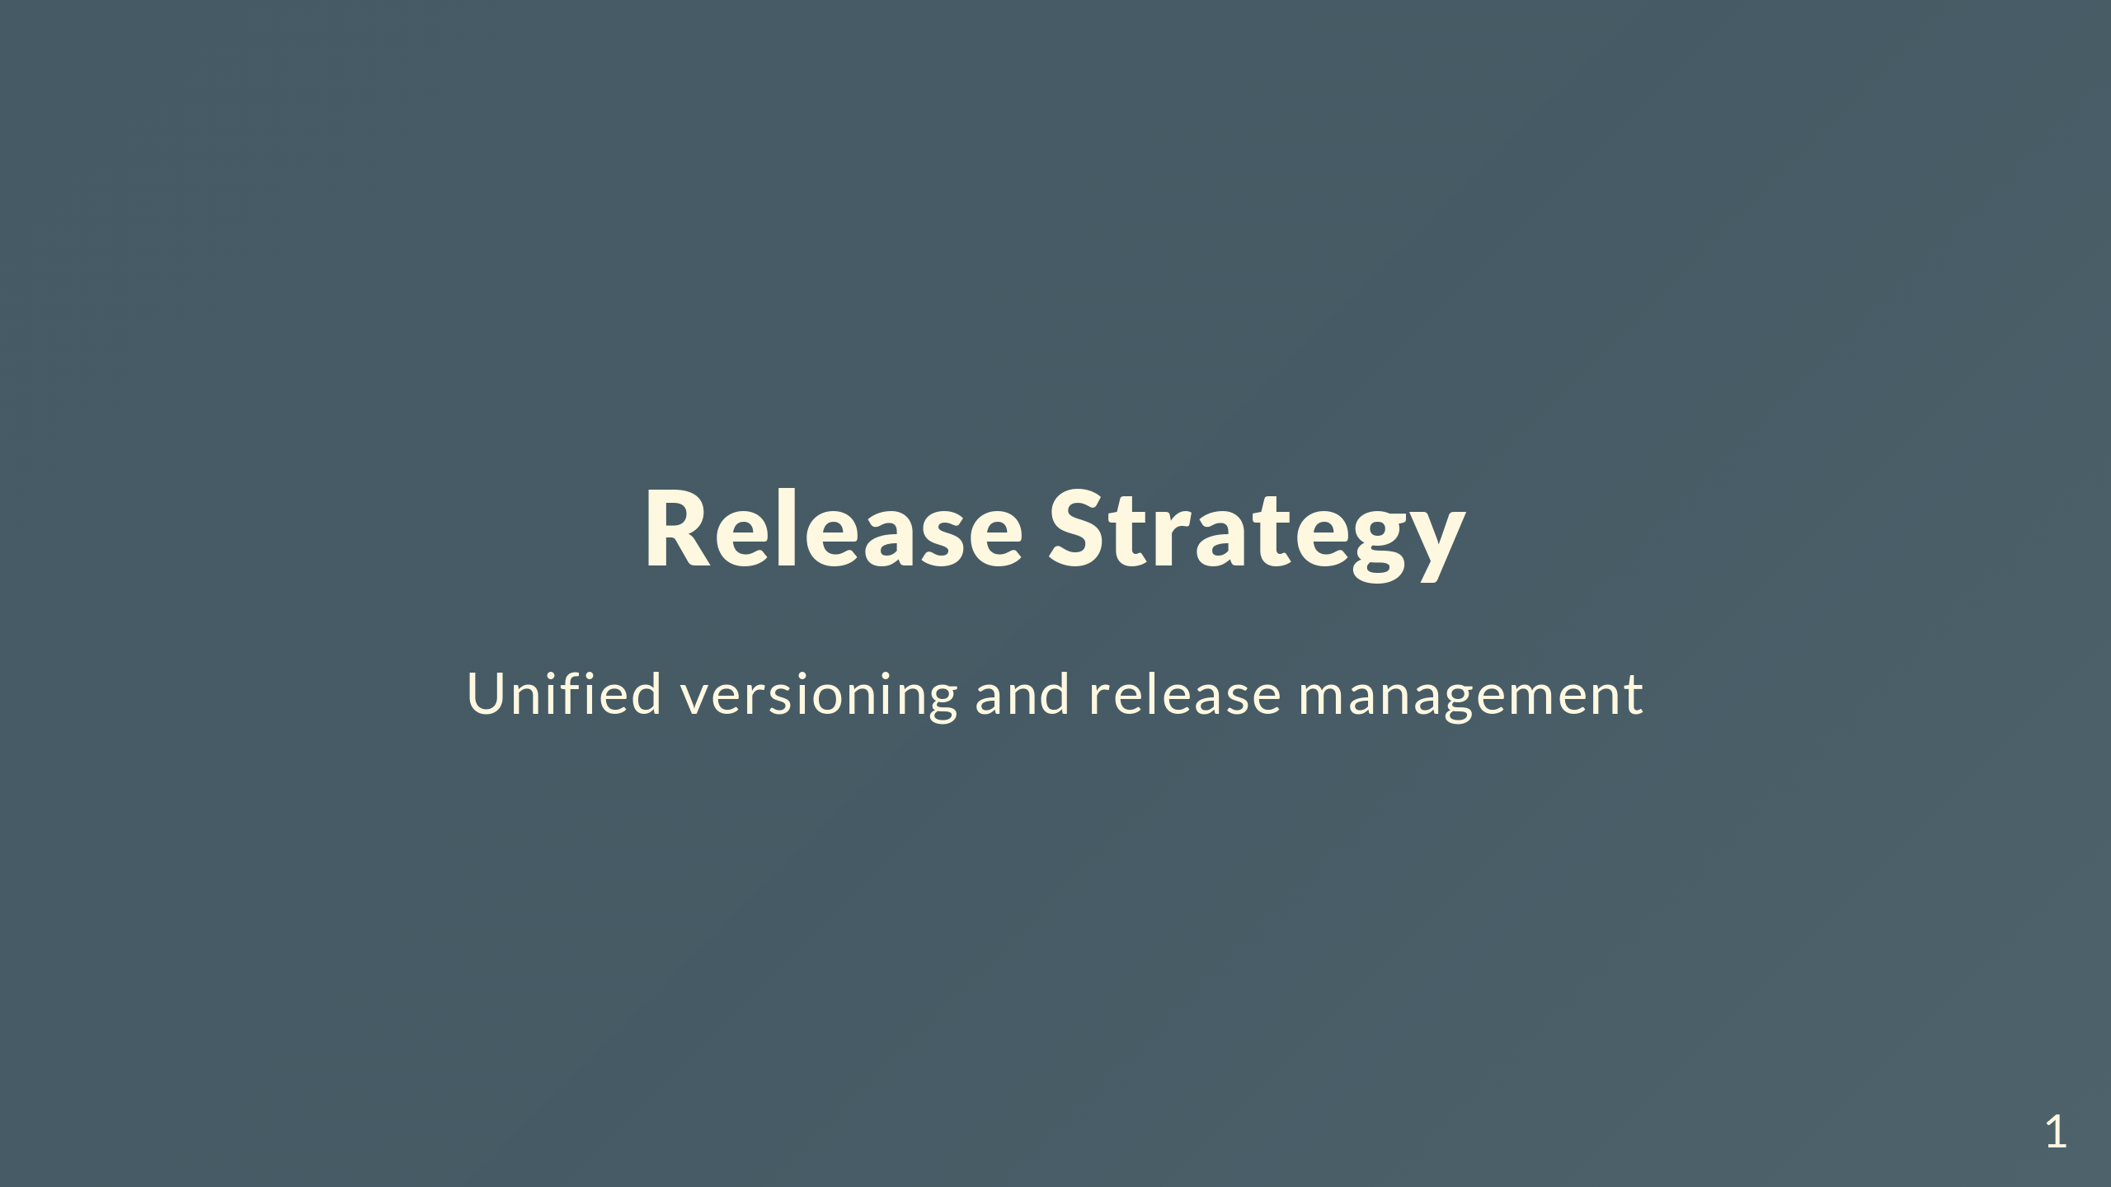
Notes:
We're going to talk about changing how we do releases. Moving away from release-please to something more explicit with unified versioning. First, where are we now?

Slide 2
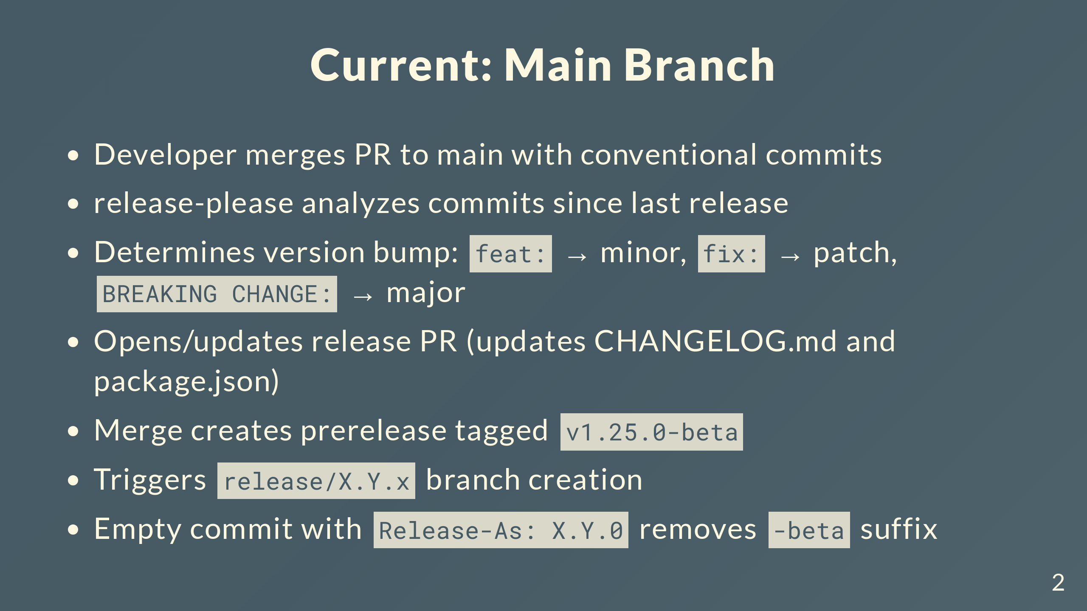
Notes:
Conventional commits are required - feat, fix, chore, etc. release-please scans all commits since last release and figures out the version bump. Opens a PR that updates the changelog and package.json. When you merge that PR, creates a GitHub release marked as prerelease with the -beta suffix, like v1.25.0-beta. That triggers a workflow that creates the release branch. Makes an empty commit with Release-As to tell release-please to bump it to stable and strip the -beta.

Slide 3
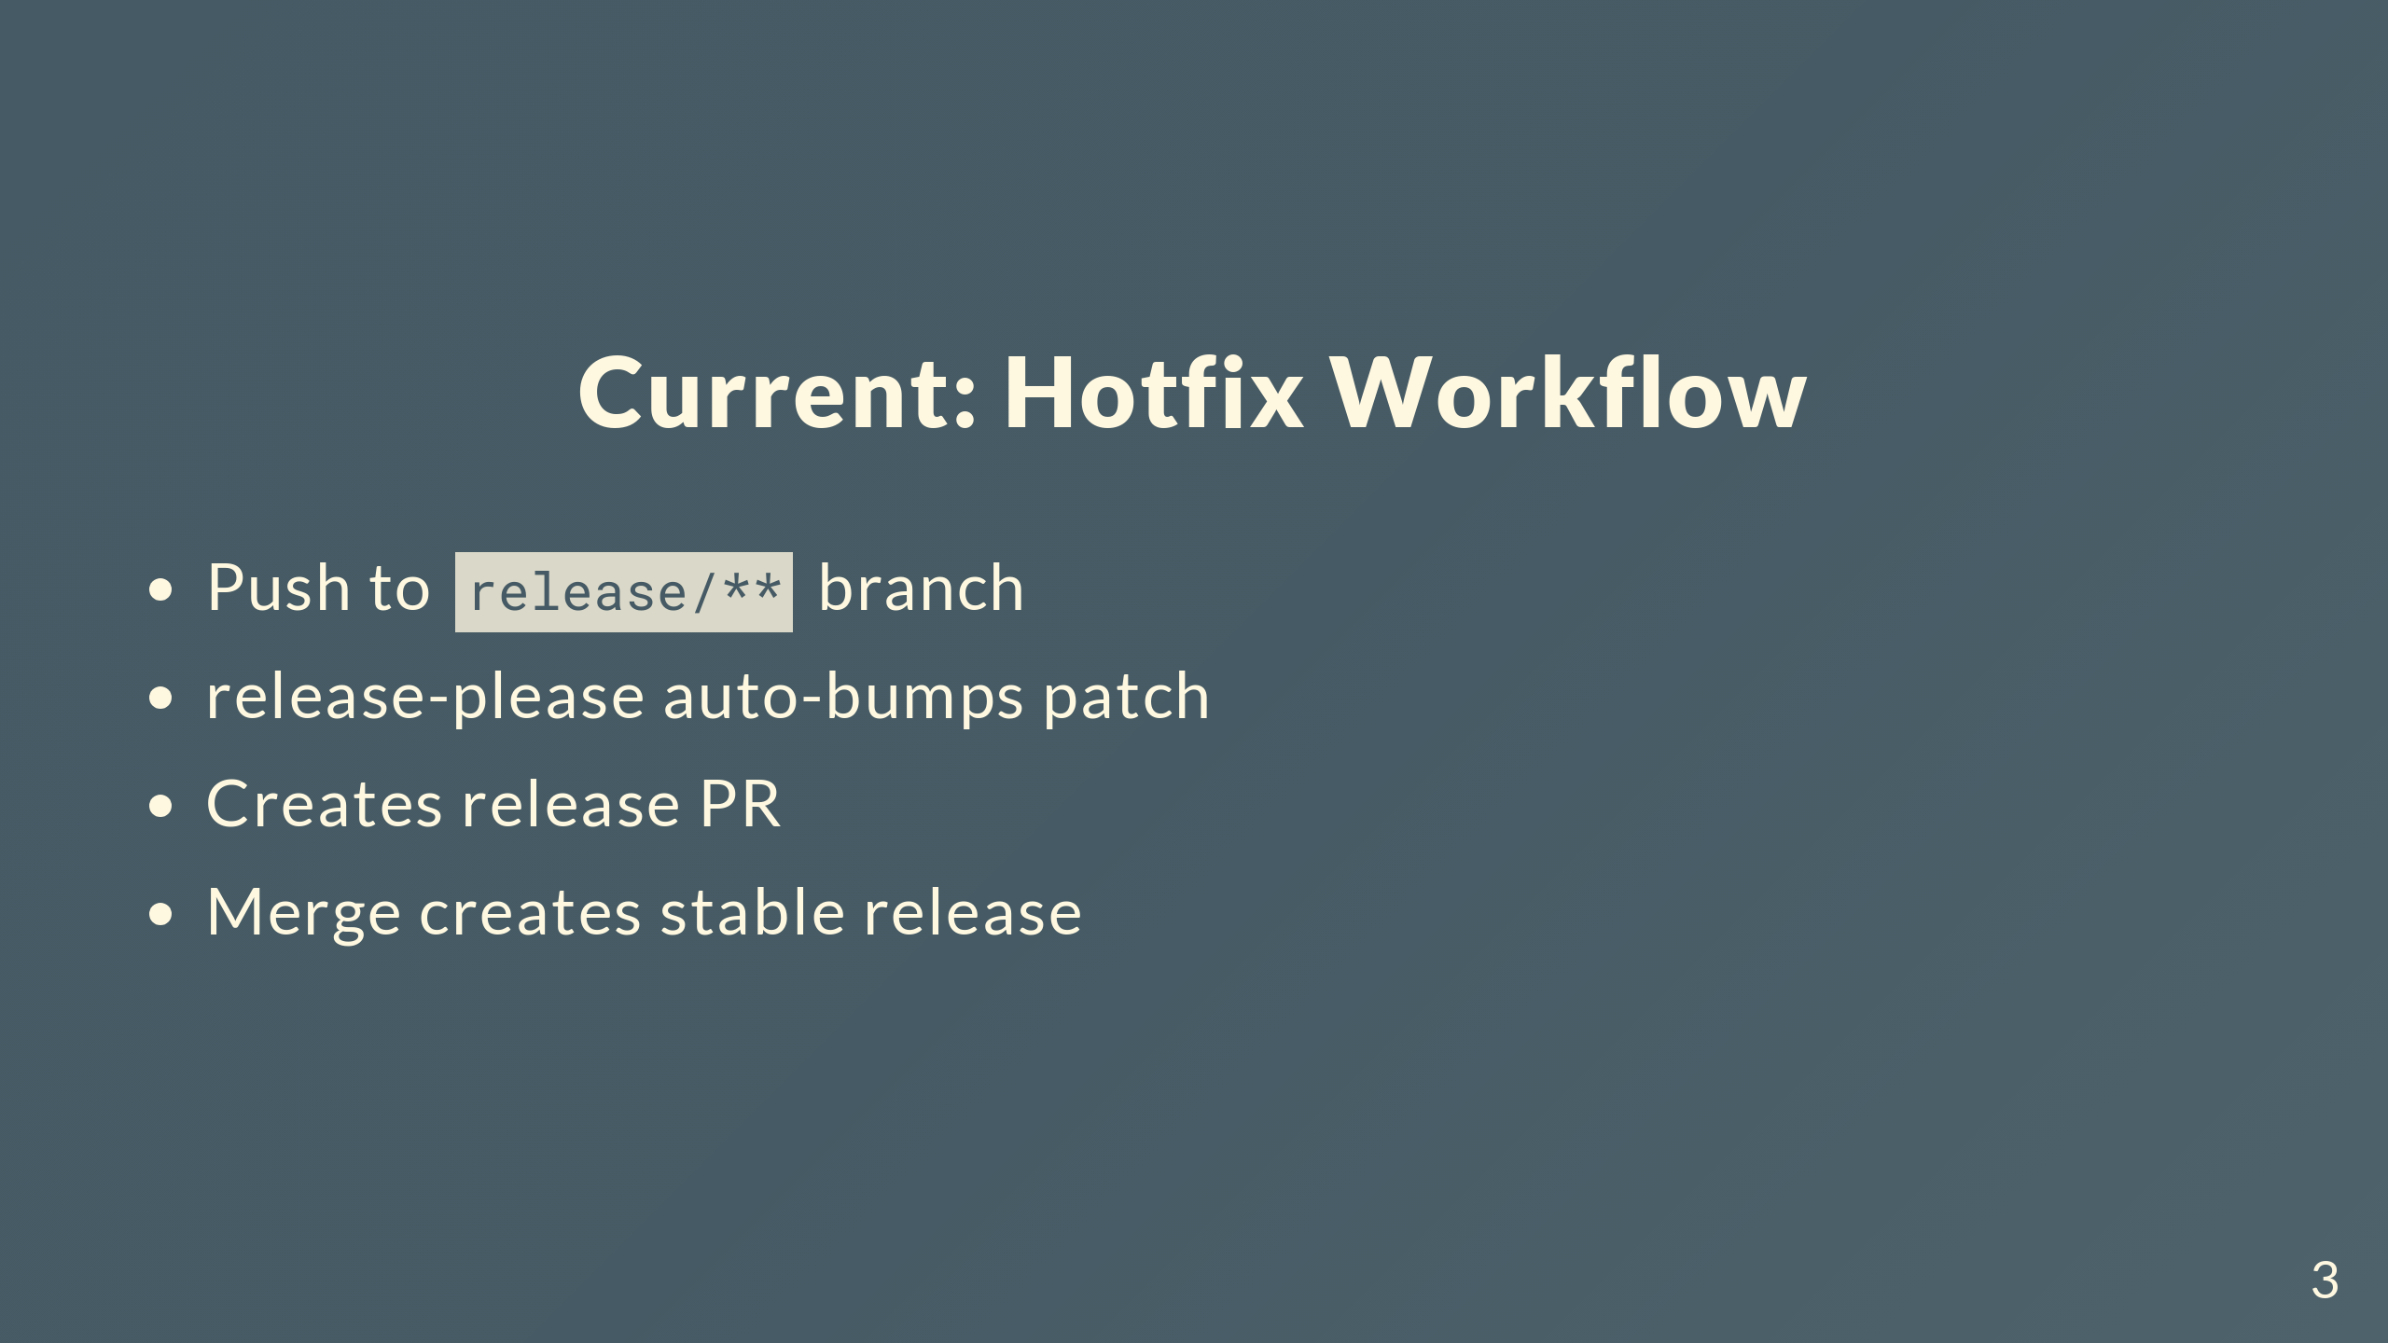
Notes:
Hotfixes work by pushing to release branches and it always bumps patch. The automation's been good, but we've outgrown it in some ways.

Slide 4
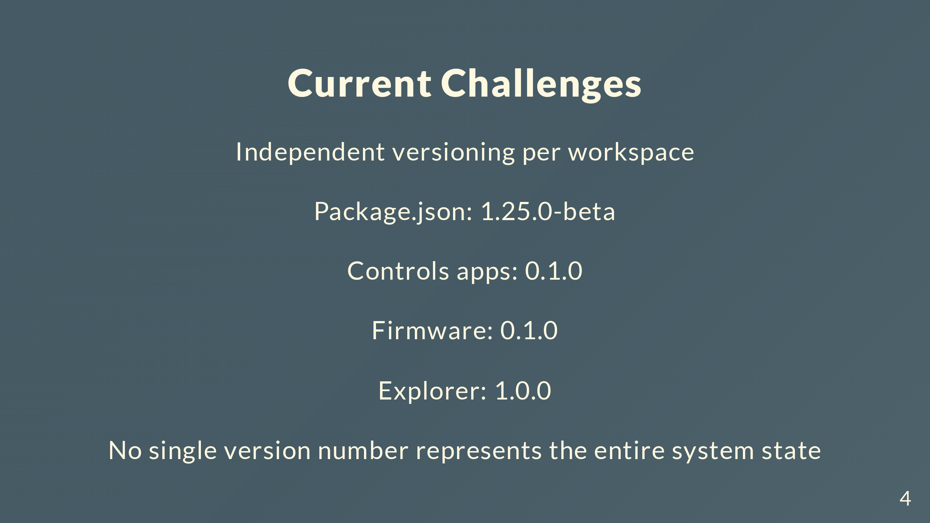
Notes:
The main challenge is tracking compatibility. When someone asks "what firmware version works with explorer 1.0.0?" there's no straightforward answer because each workspace has independent versioning. We need a single version that represents the state of the entire system.

Slide 5
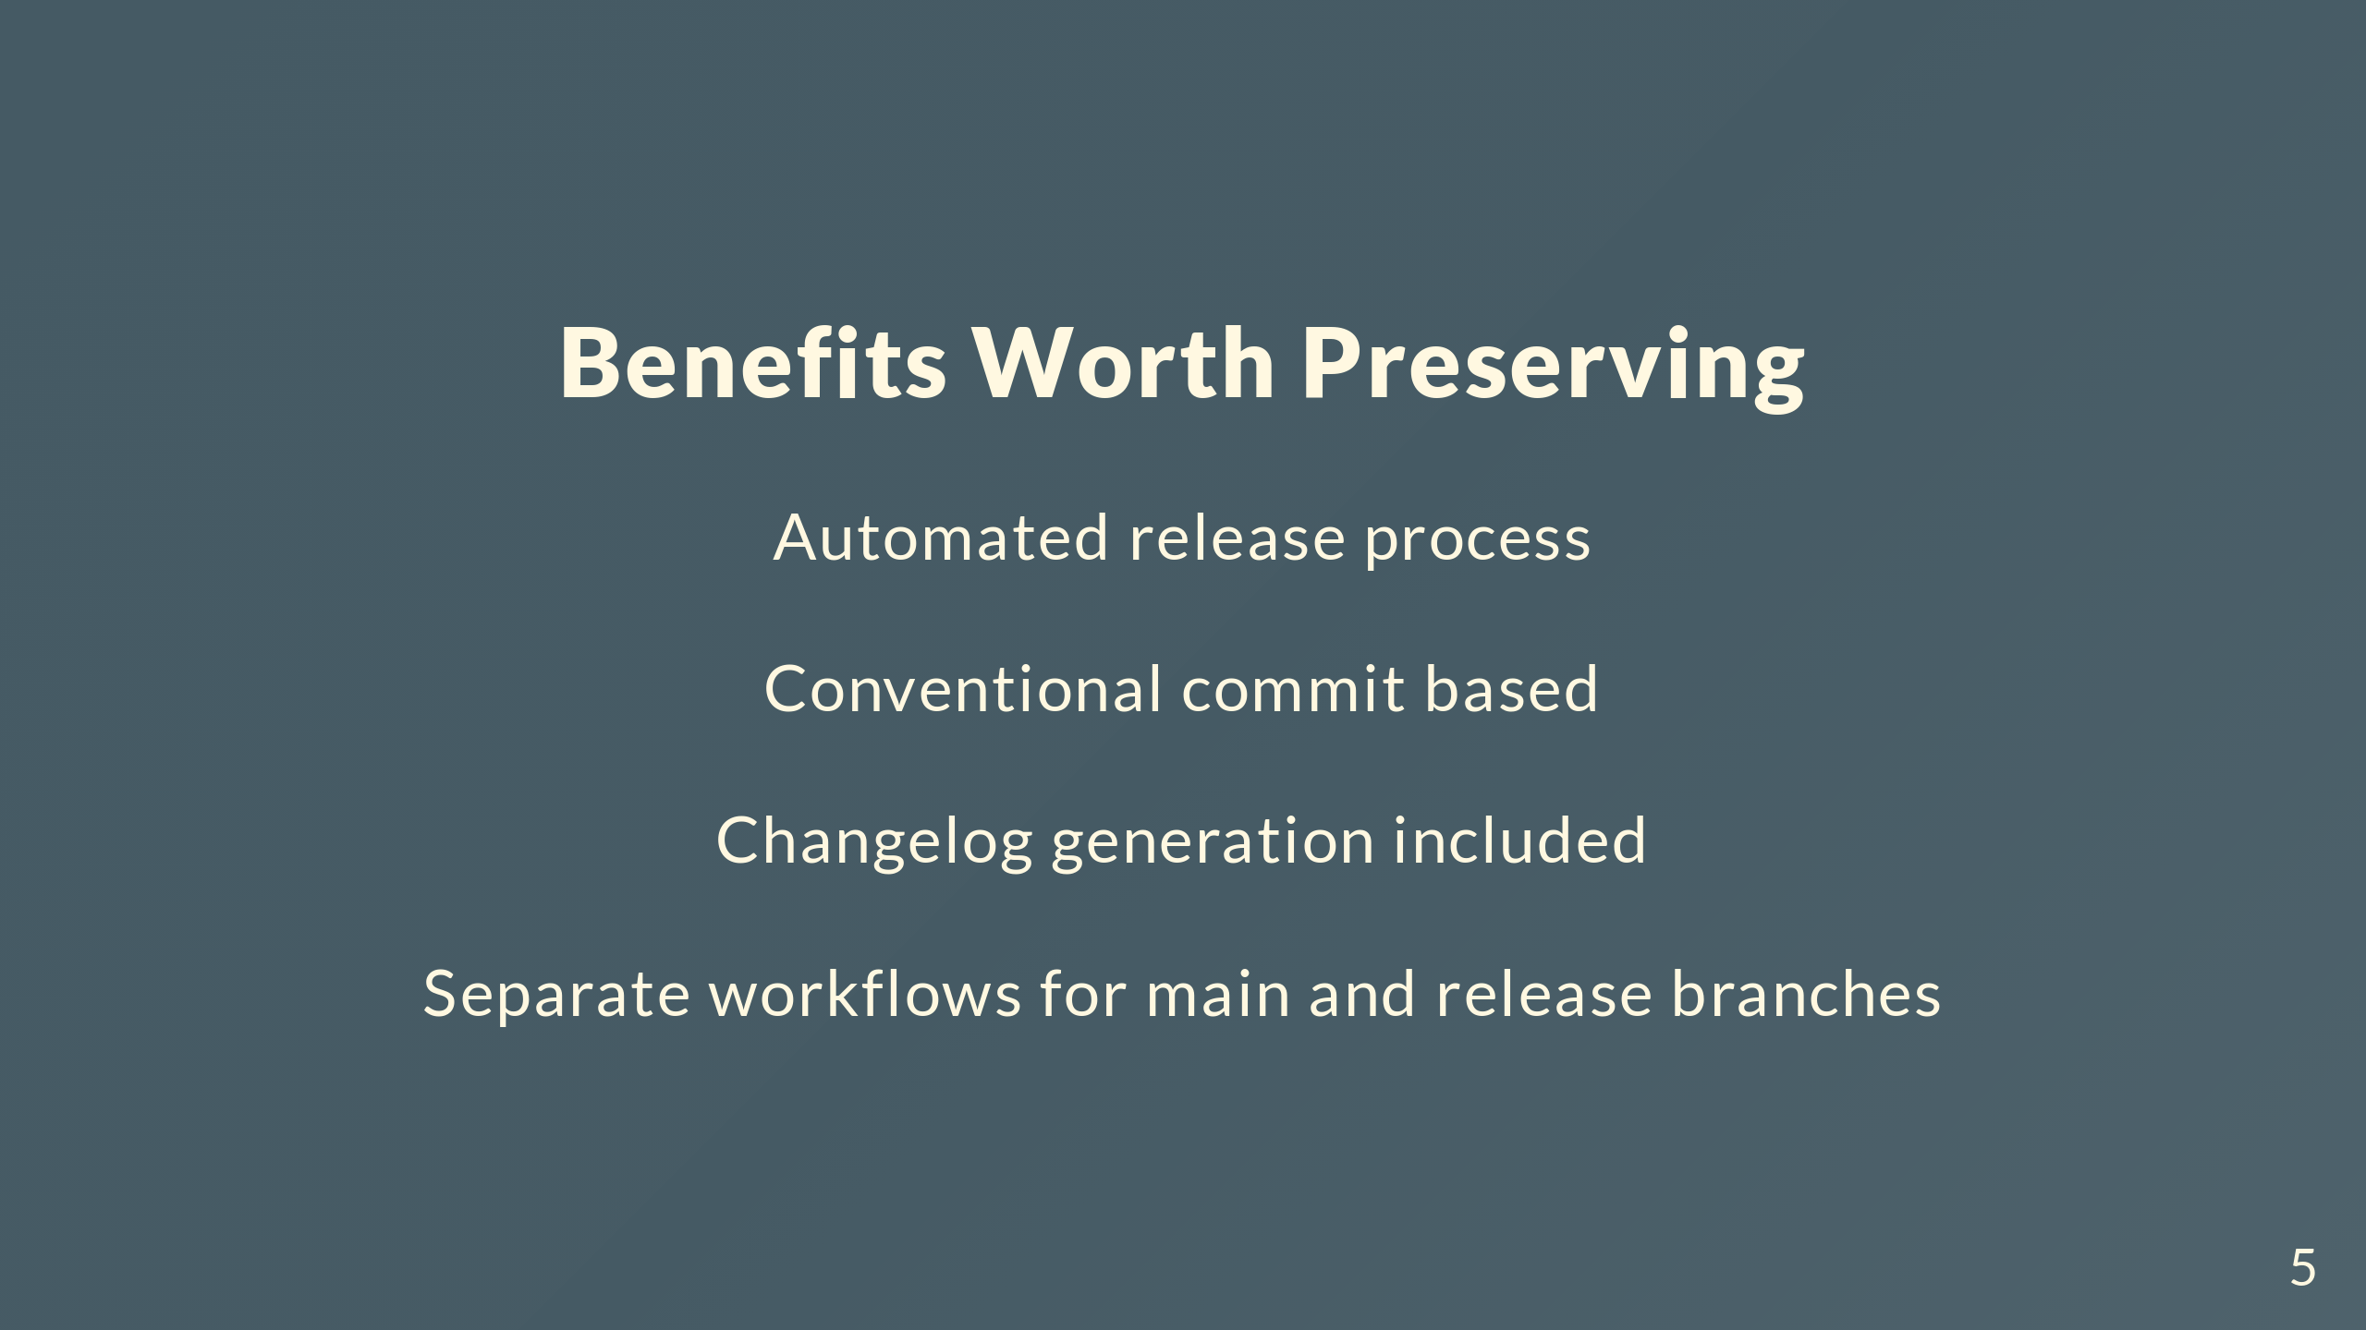
Notes:
Current setup does have things we want to keep. Not manually editing changelogs and versions is huge. Conventional commits keep things consistent. Separate workflows for main and release branches makes sense. Keep all that, fix the versioning mess.

Slide 6
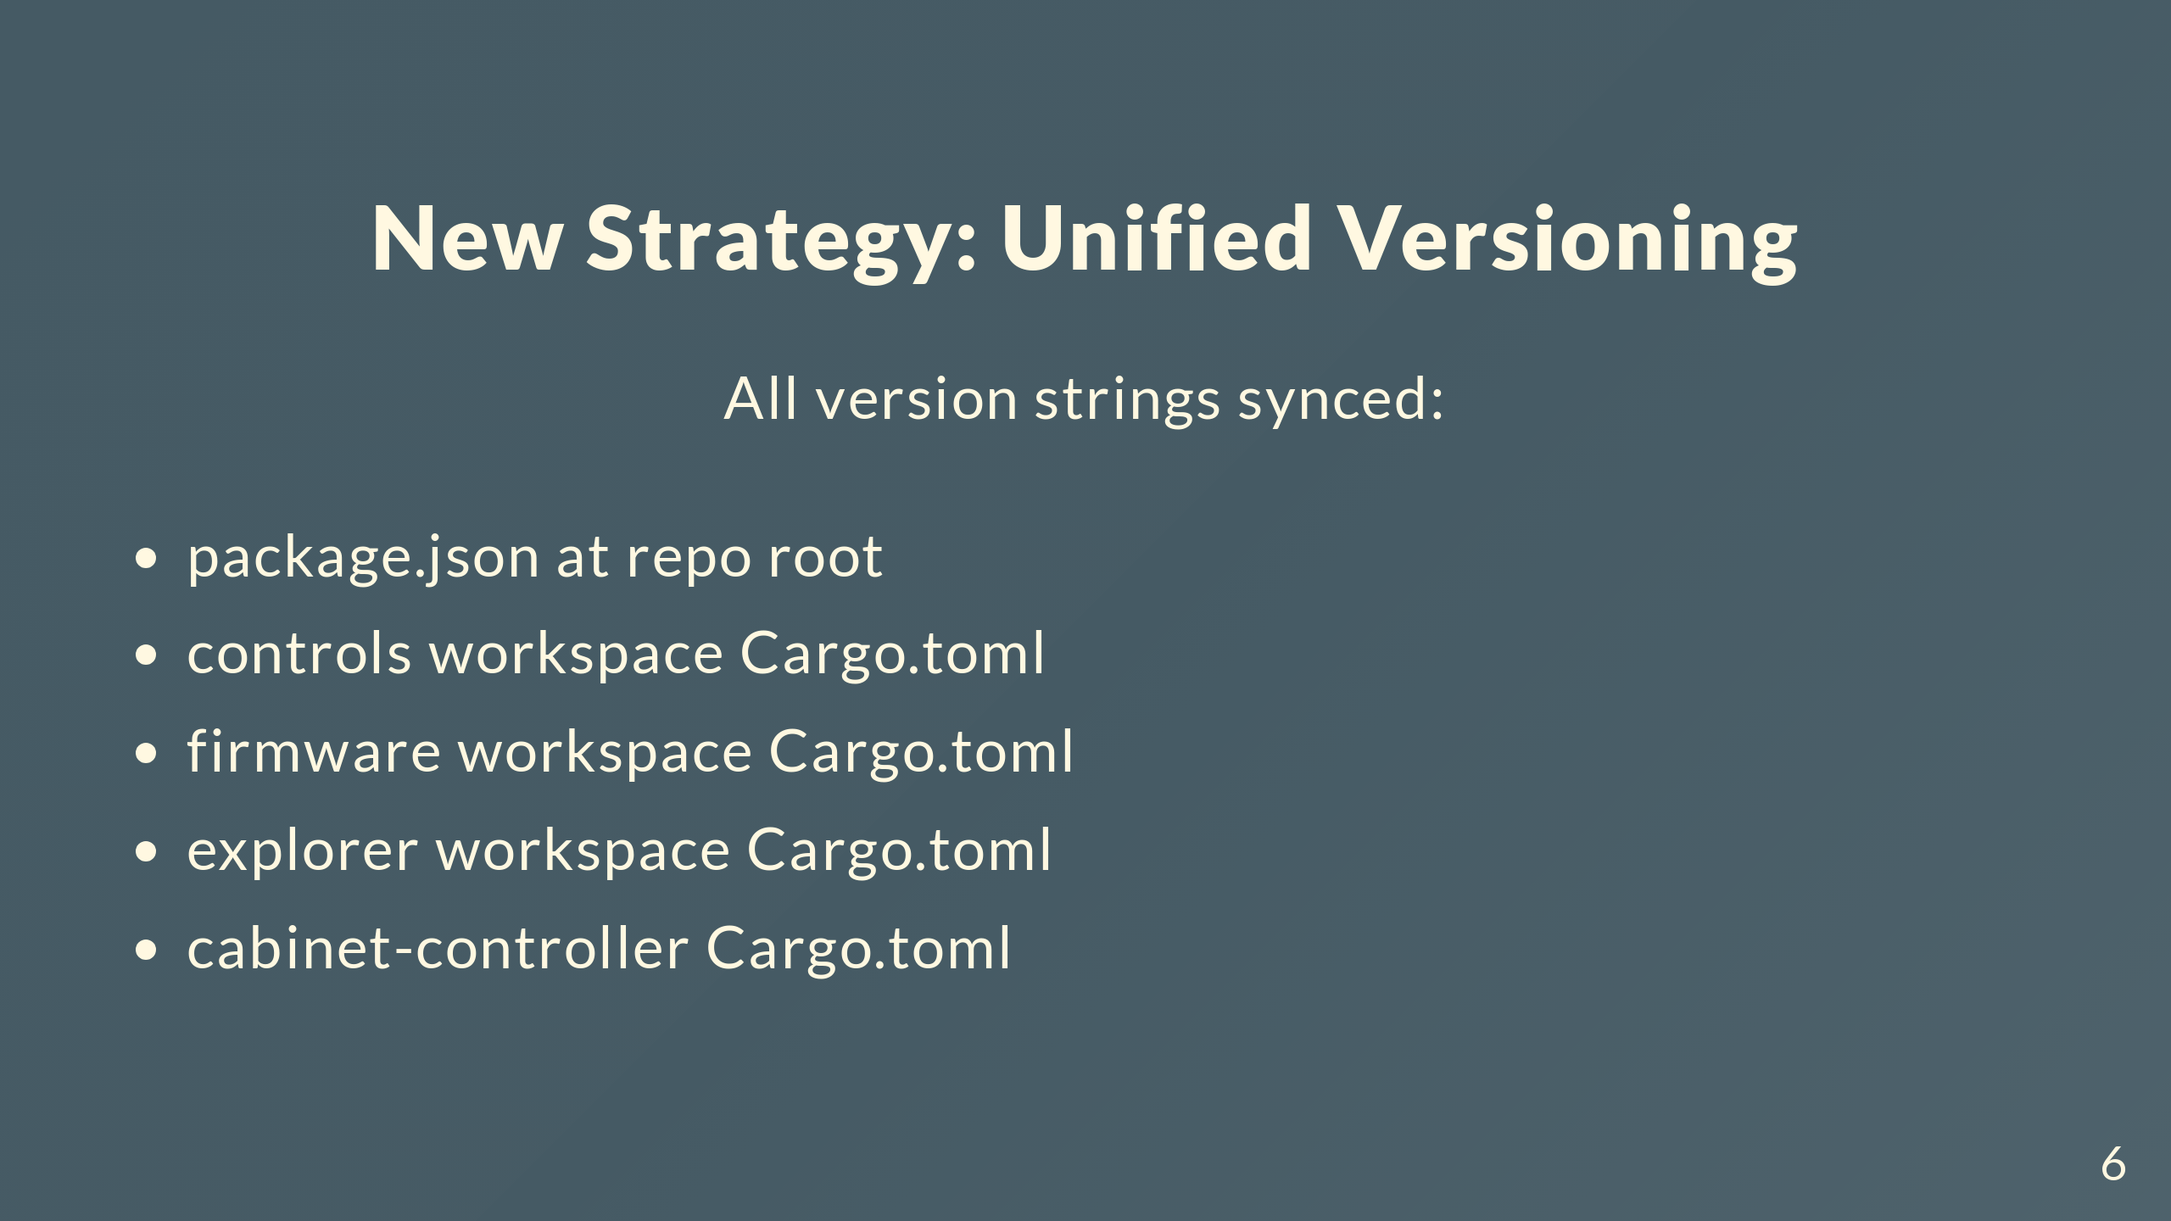
Notes:
New approach is simple: one version for everything. All 5 version locations stay in sync. Say "version 1.26.0" and you know exactly what you're getting for every component.

Slide 7
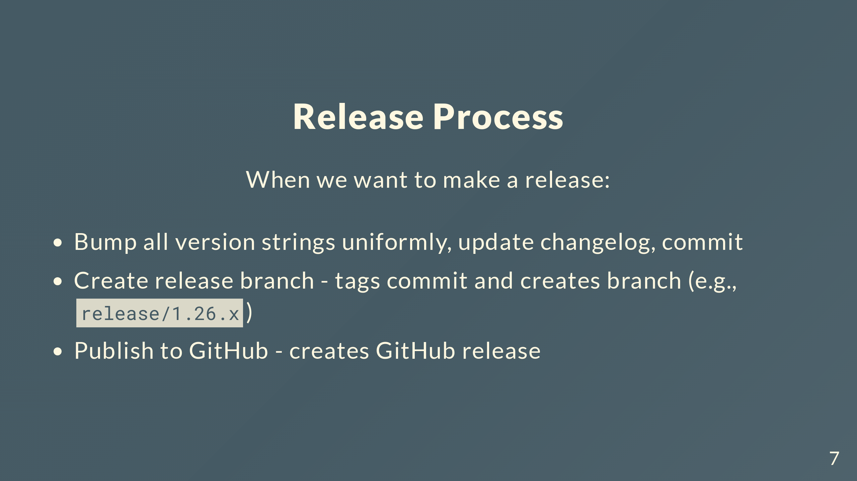
Notes:
Simple process. Bump everything at once and commit. Create release branch tags that commit and makes the branch. Publish creates the GitHub release.

Slide 8
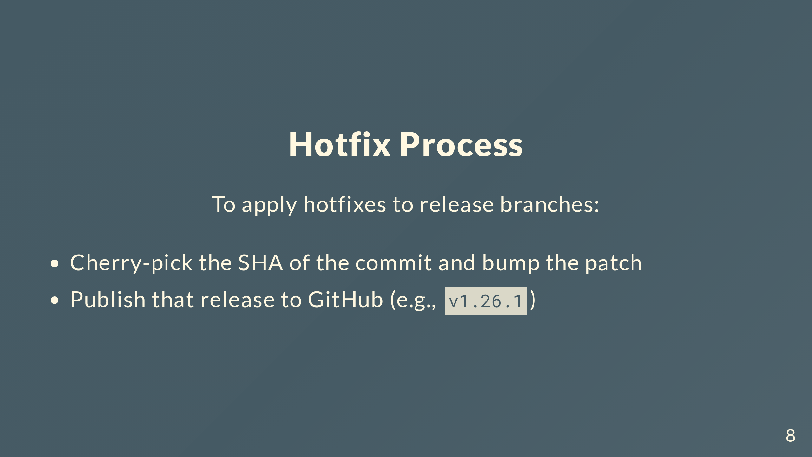
Notes:
Hotfixes are straightforward. Cherry-pick the commit, bump patch, publish.

Slide 9
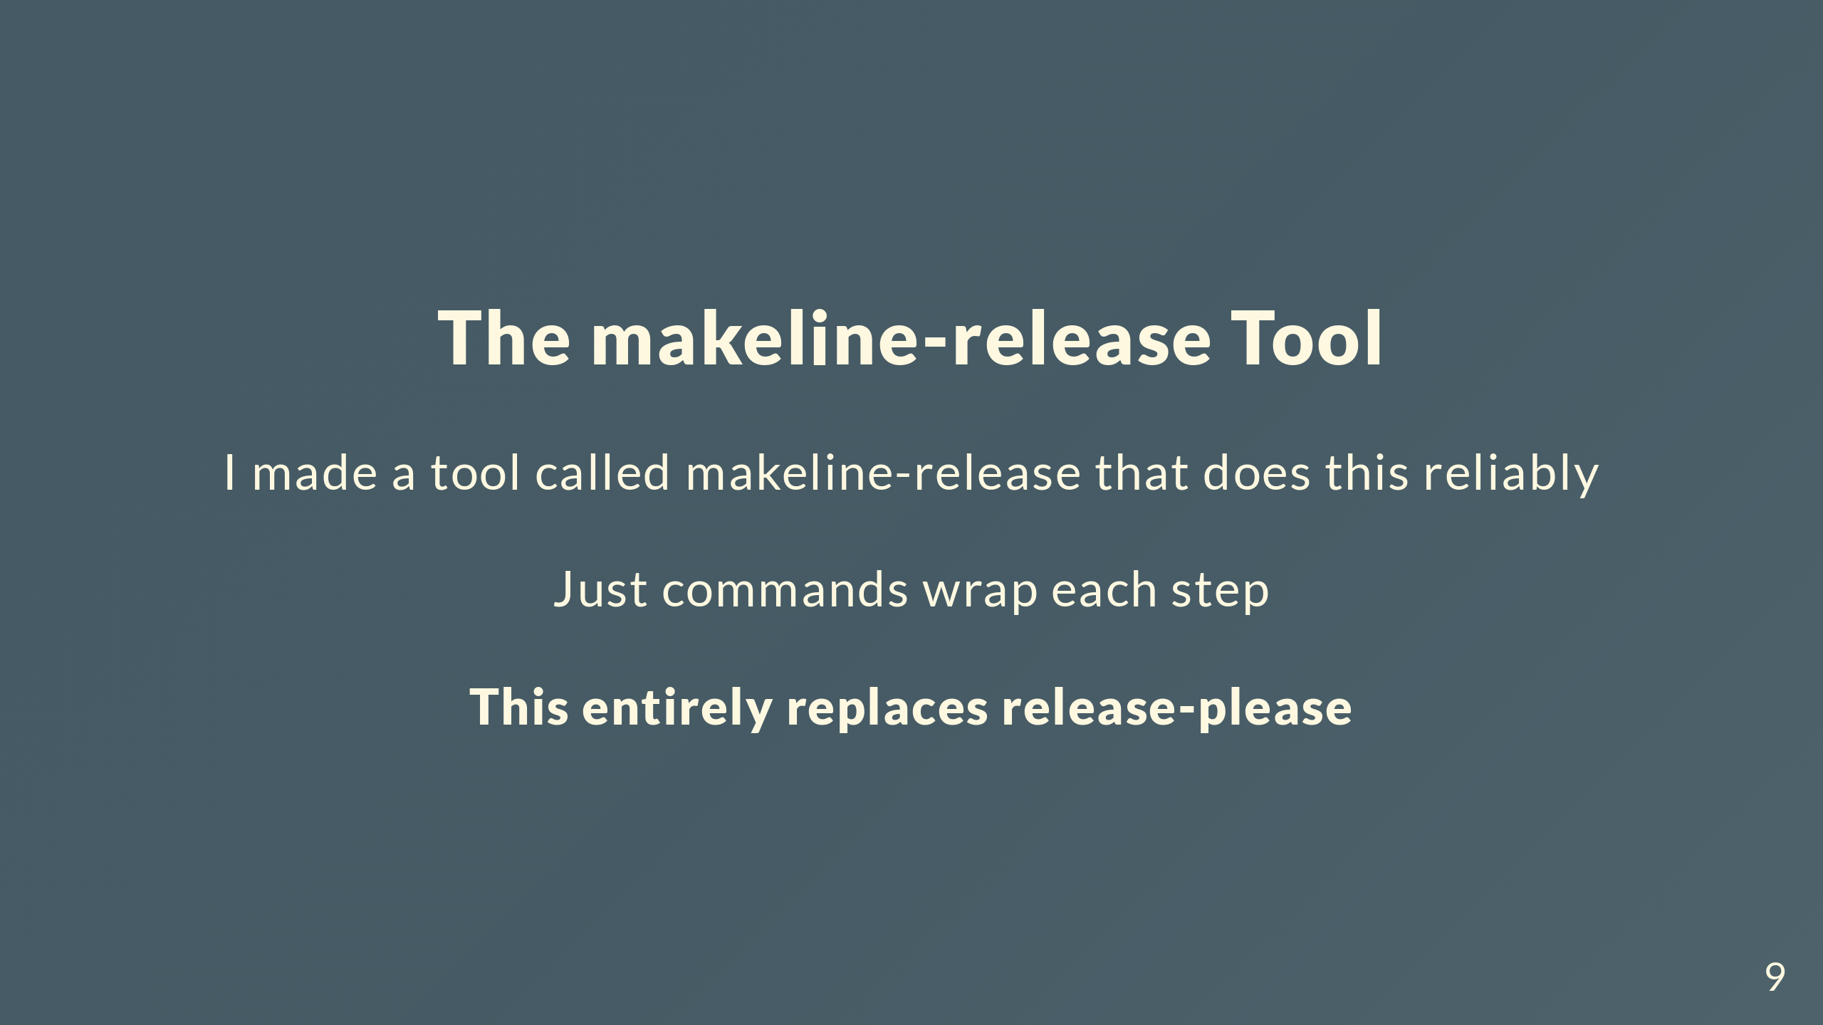
Notes:
Built makeline-release to handle all of this. Wrapped it in Just commands for convenience. This completely replaces release-please.

Slide 10
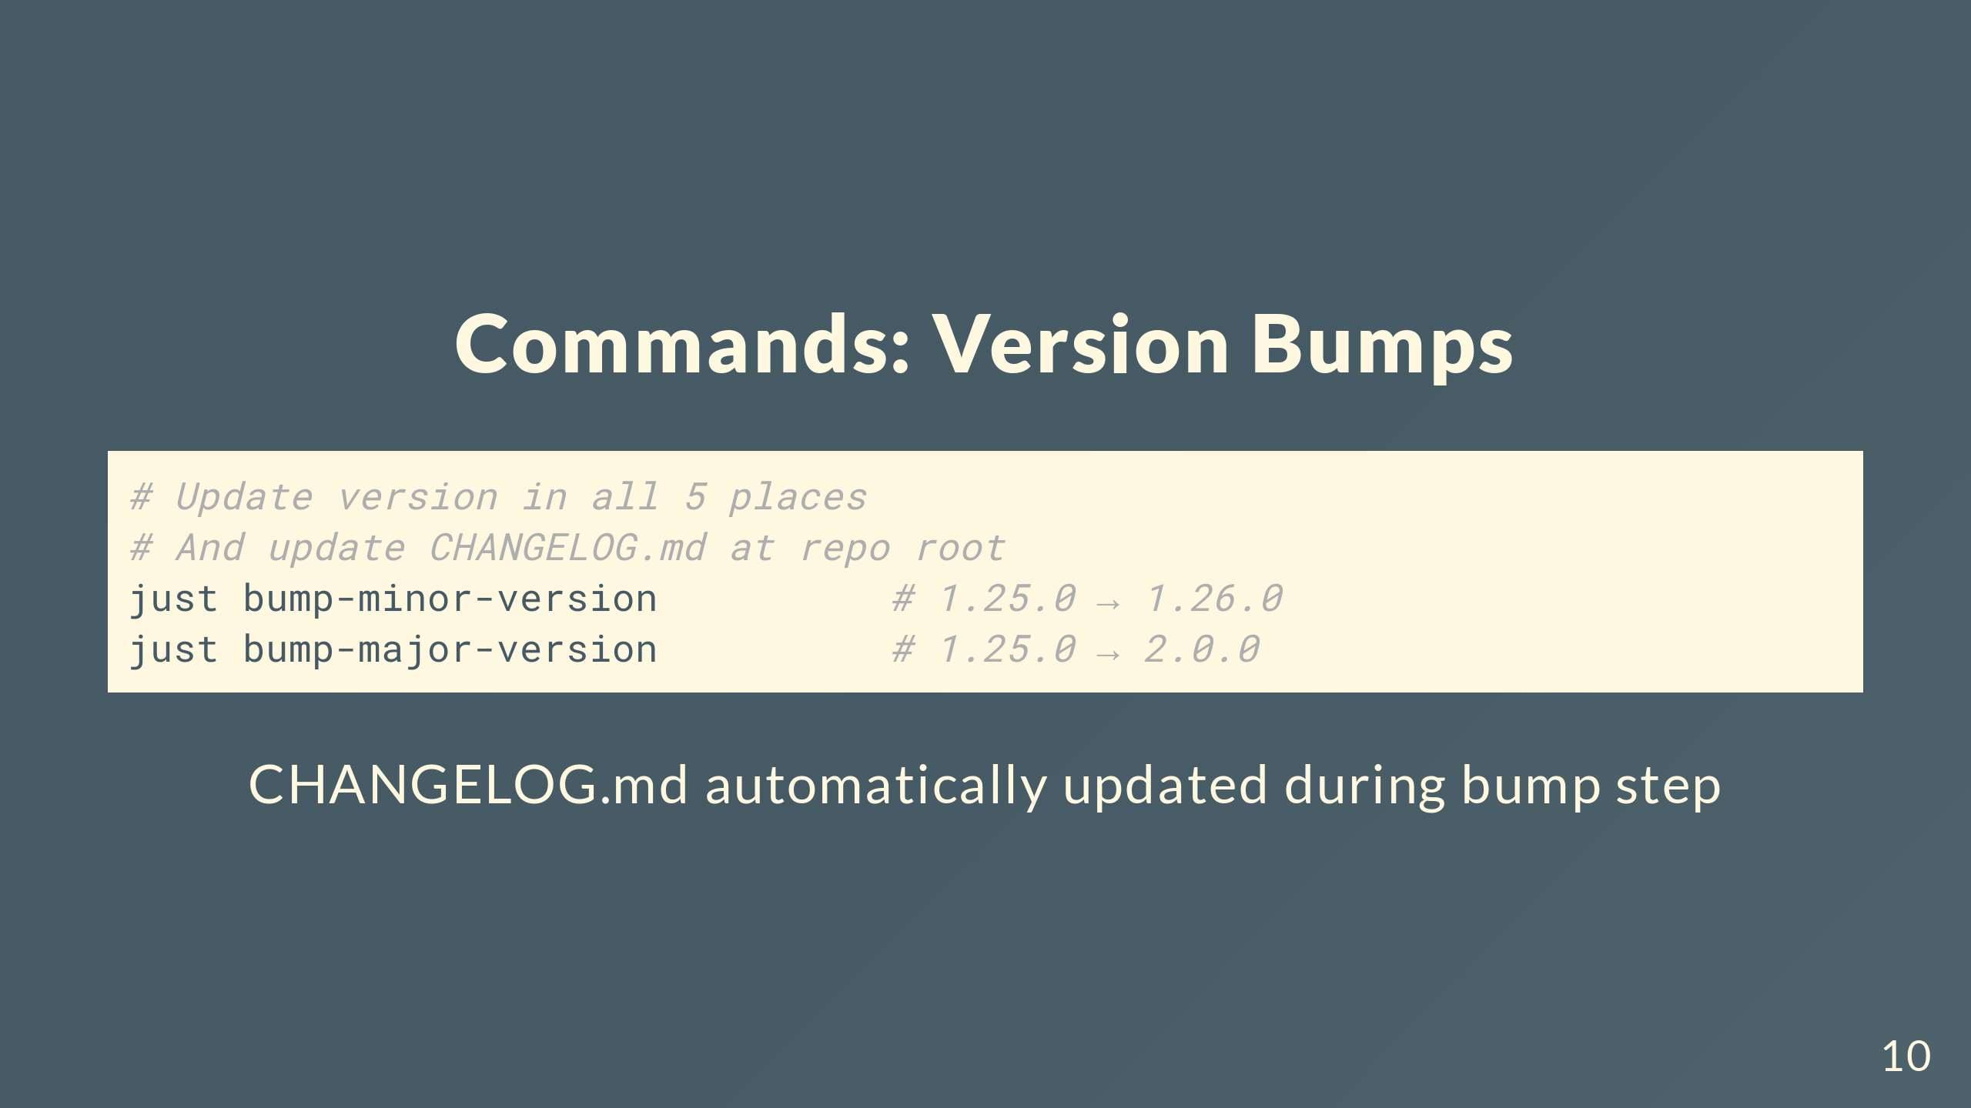
Notes:
Bump commands update all 5 version locations and regenerate the changelog automatically during the bump. One command, everything synced.

Slide 11
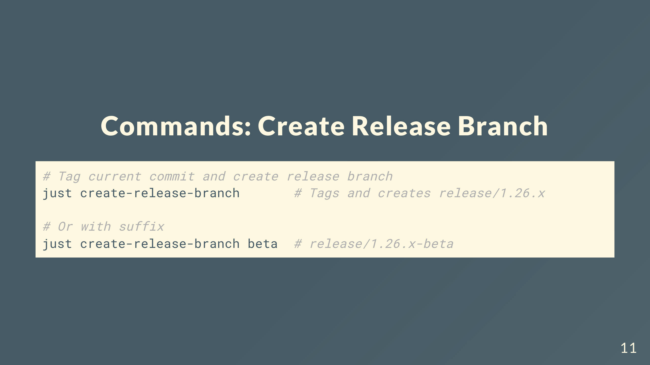
Notes:
Tags the current commit on main and creates the release branch from that tag. Can add a suffix if you need to differentiate releases at the same suite version.

Slide 12
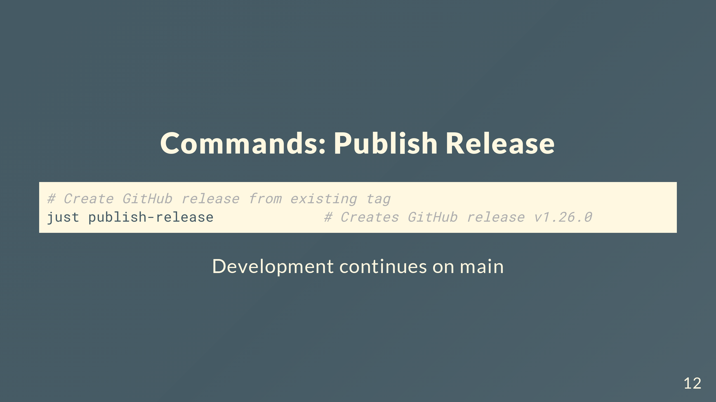
Notes:
Publishes the GitHub release from the tag that was created during branch creation. Development keeps going on main while the release branch exists.

Slide 13
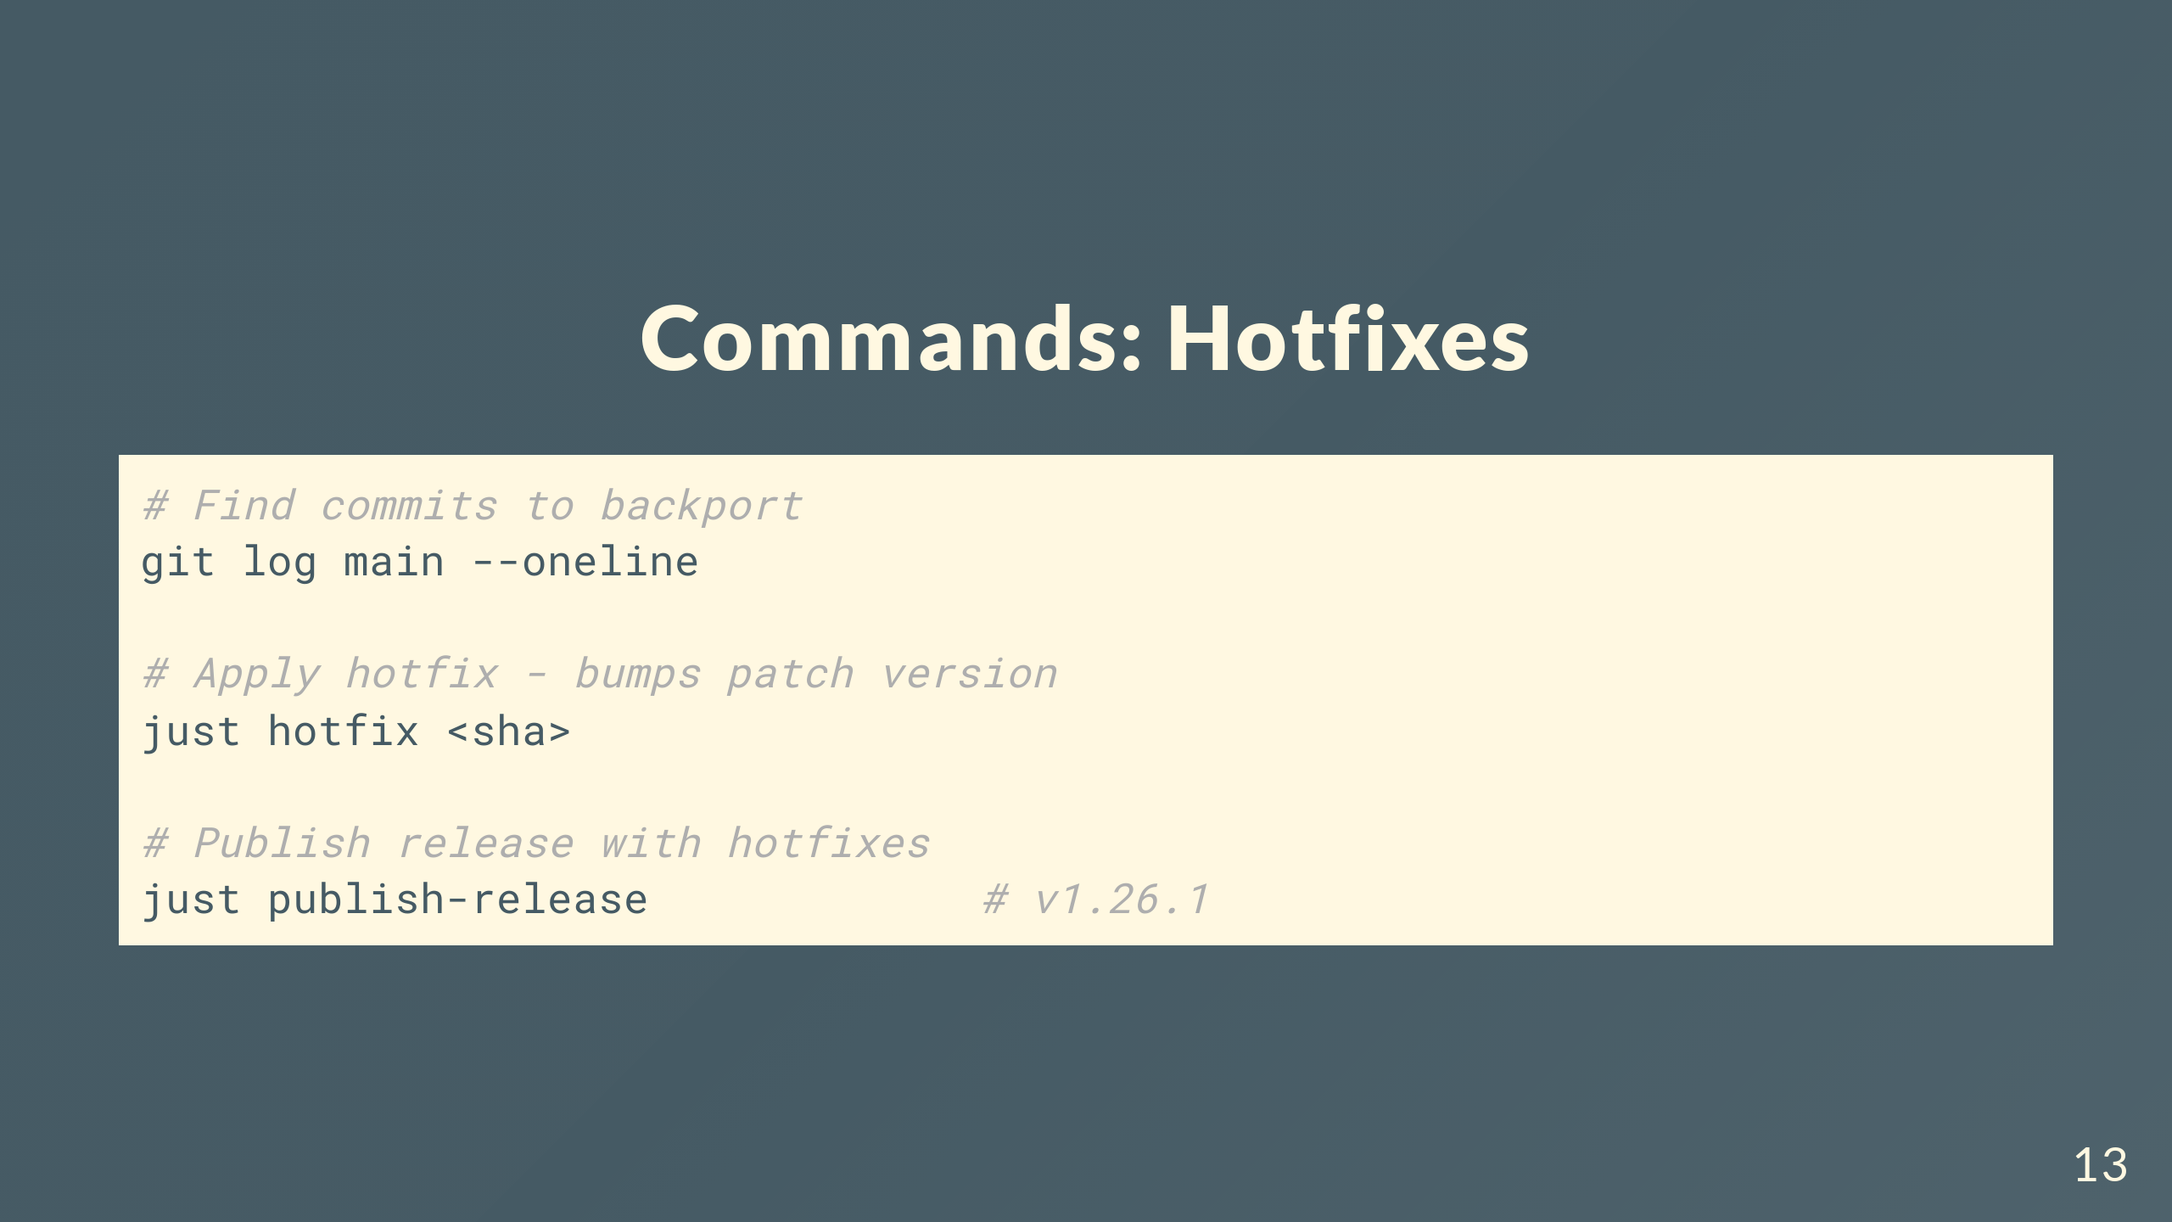
Notes:
When you need to backport commits, find the SHA from main, run just hotfix with it. Cherry-picks and bumps patch automatically. Then publish.

Slide 14
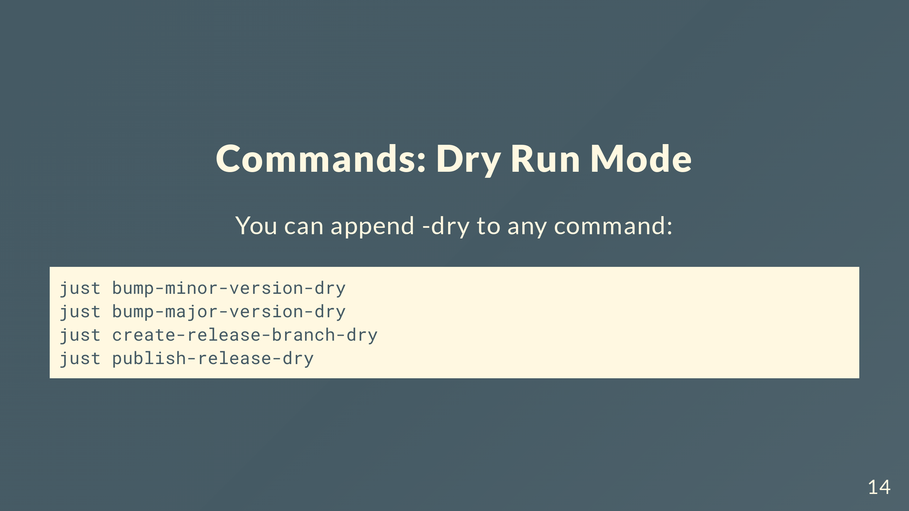
Notes:
Every command has dry run mode. See what would happen without making changes.

Slide 15
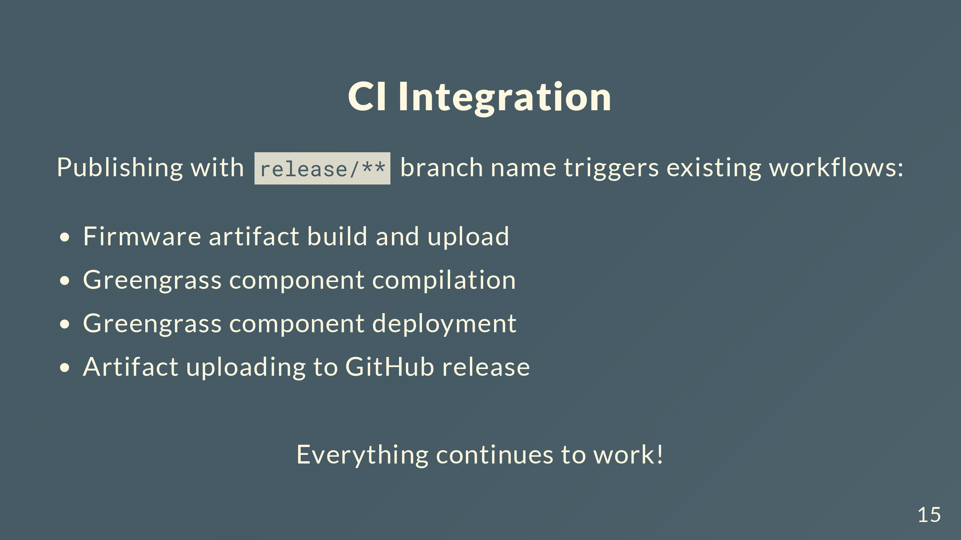
Notes:
Publishing a release from a release/** branch automatically triggers all our existing CI workflows for firmware artifacts and Greengrass components. Everything that happens after a release is published still works correctly.

Slide 16
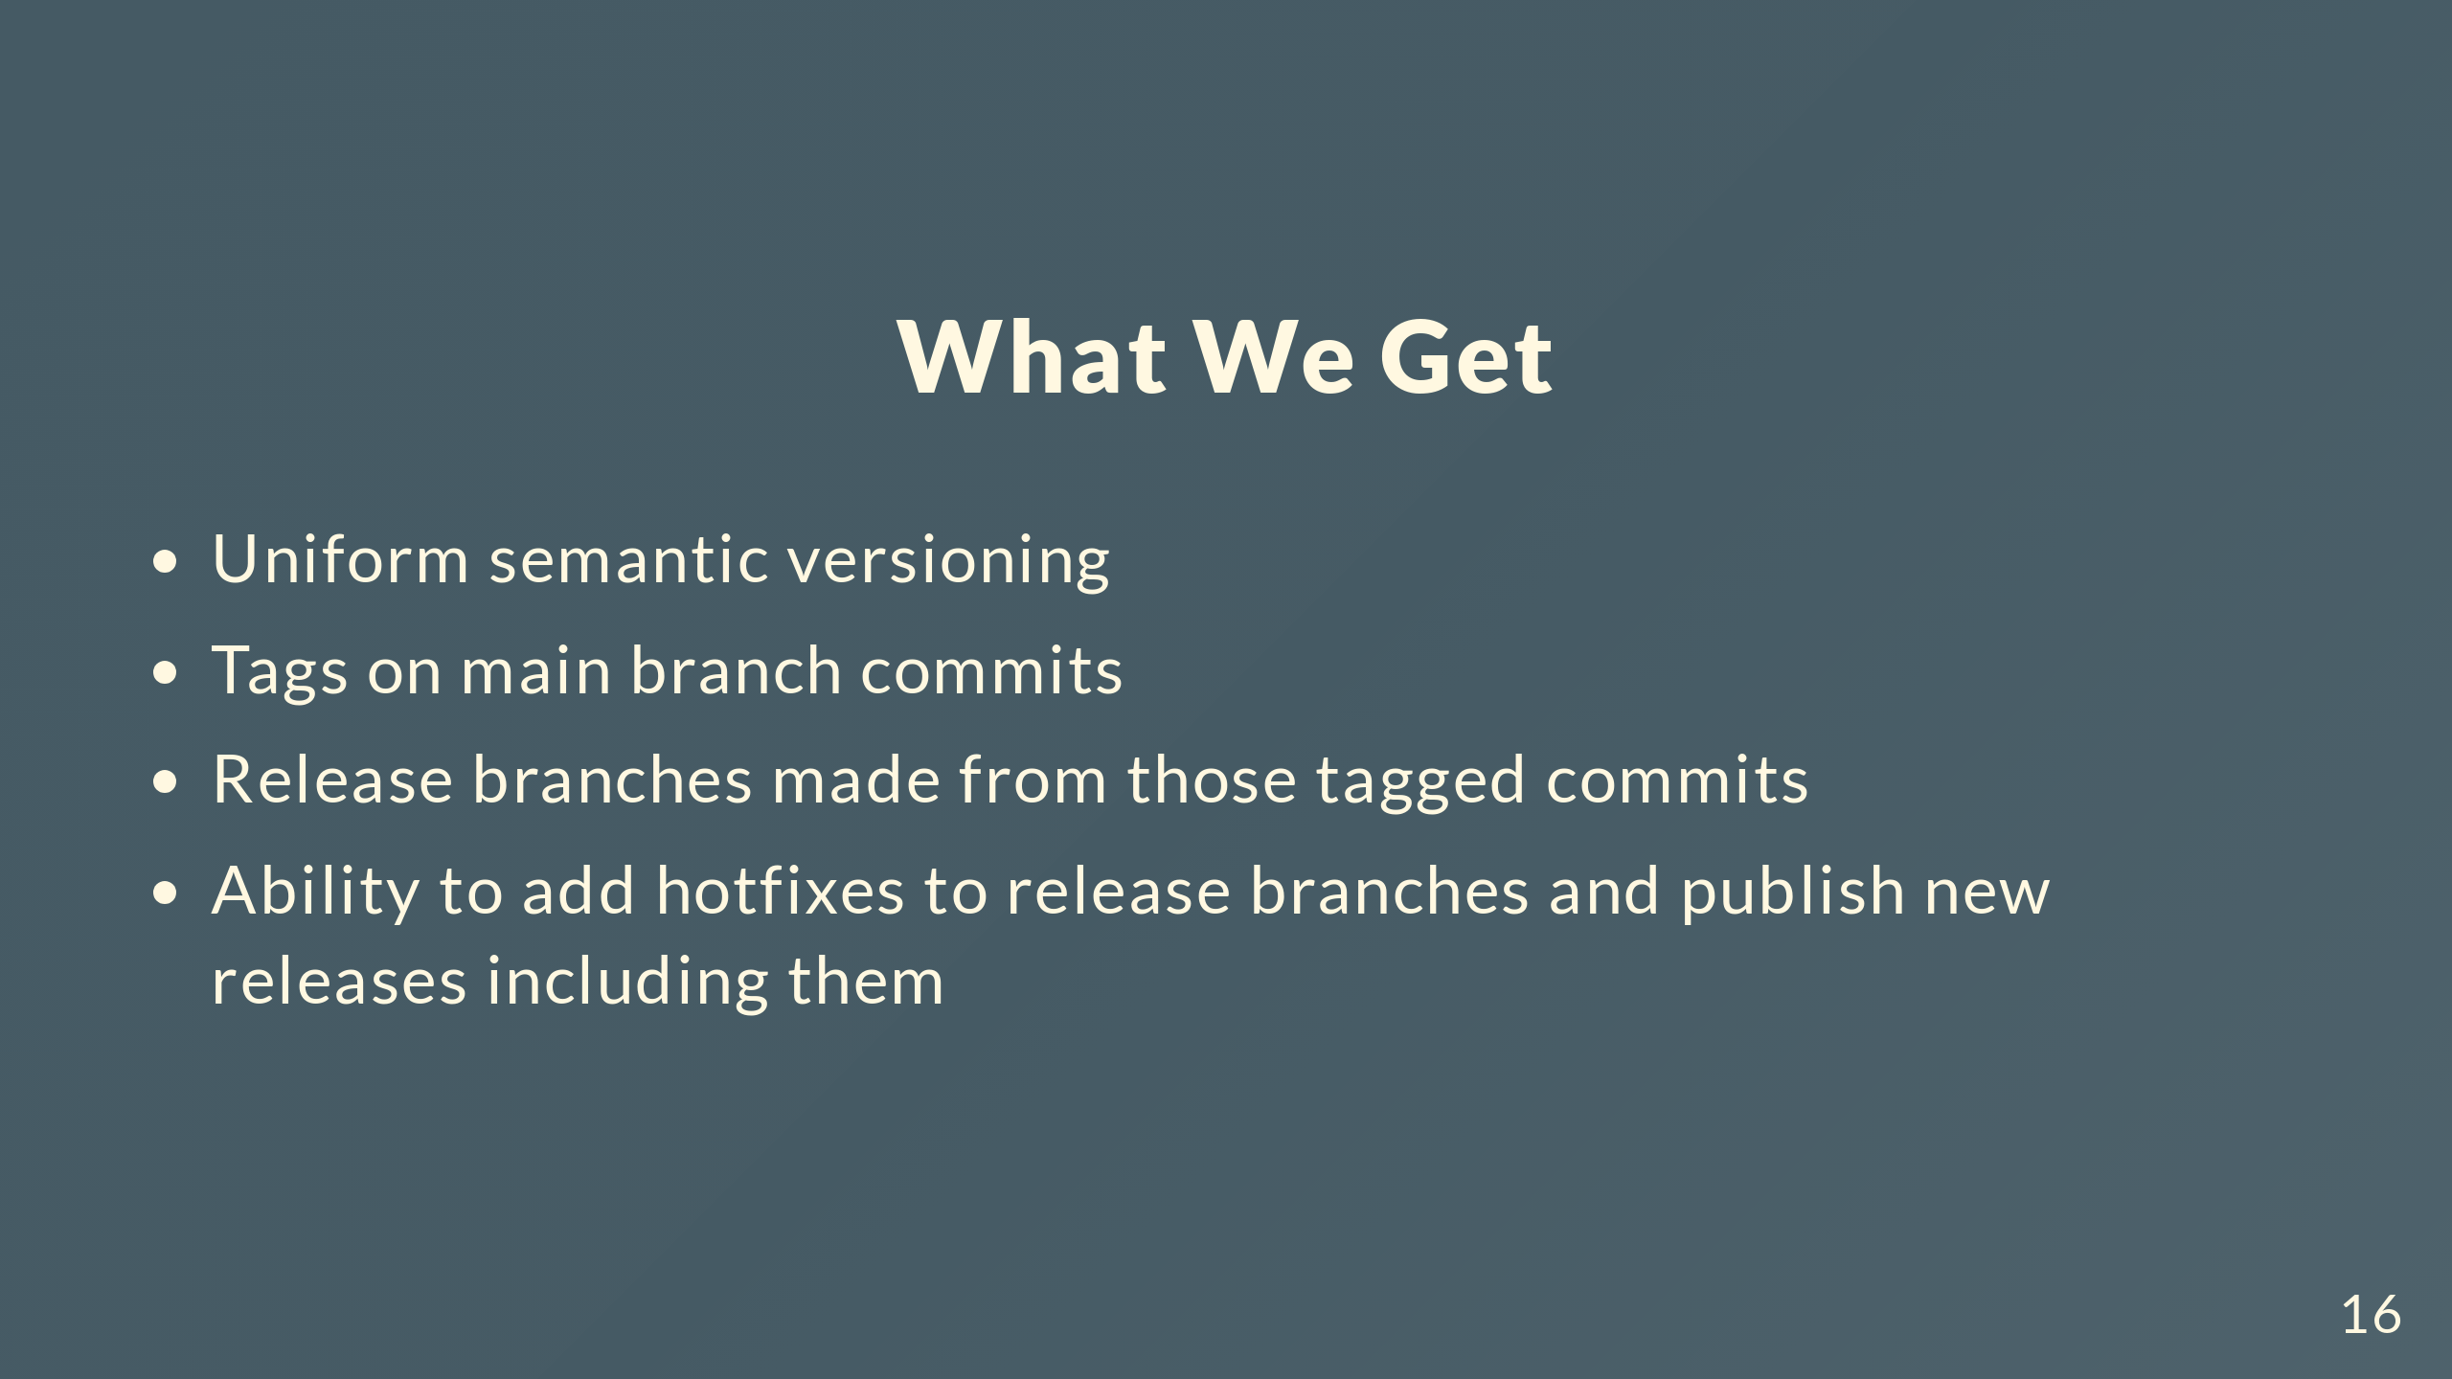
Notes:
In the end, unified versioning across everything, tags on main marking releases, release branches from those tags, and proper hotfix workflow.

Slide 17
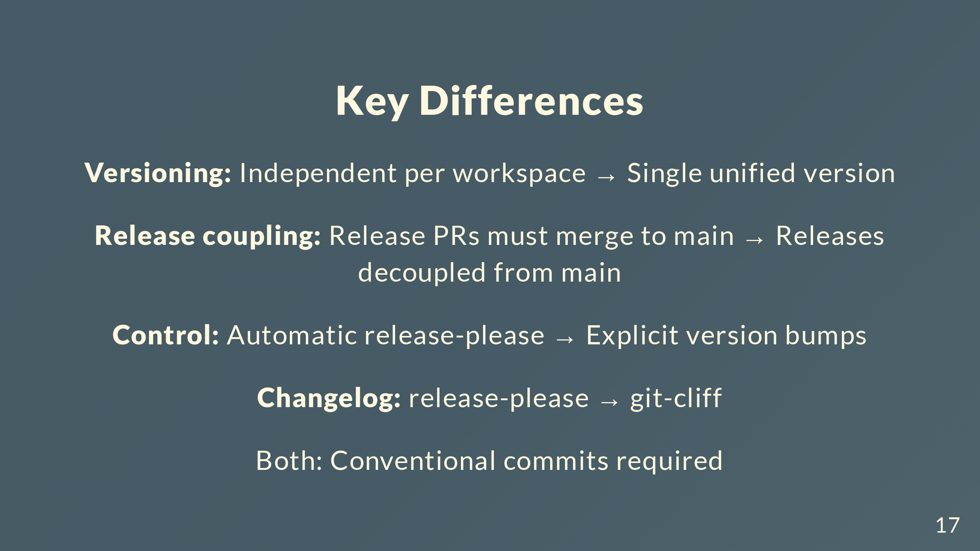
Notes:
Main differences. Old way: independent versions per workspace. New: single version. Old: you have to merge release PRs into main to create releases. New: development on main is completely decoupled from releases. You decide when to cut a release by running bump commands. Old: release-please does everything. New: explicit control with makeline-release. Switching from release-please's changelog to git-cliff. Both need conventional commits though, so devs don't change anything there.

Slide 18
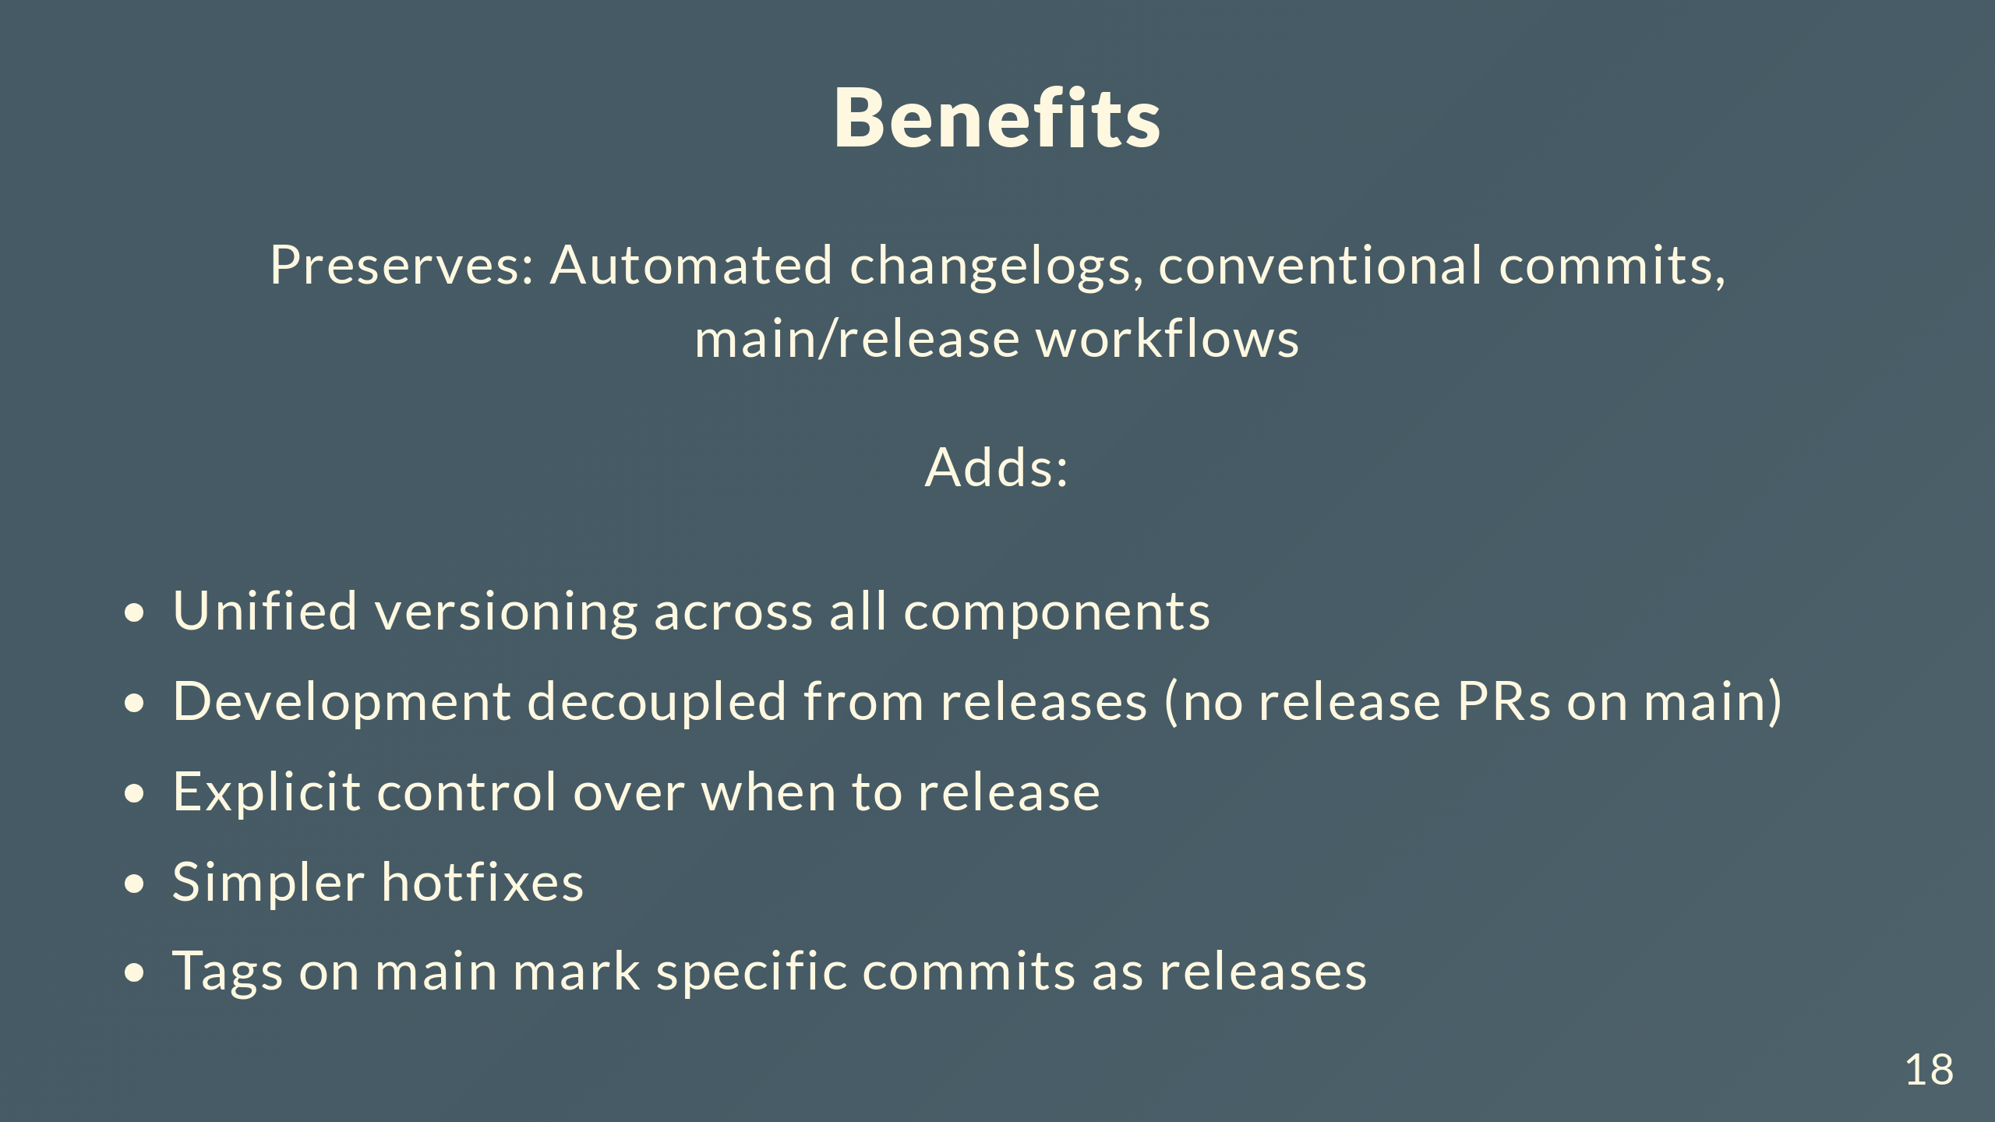
Notes:
What do we get? Keep the good stuff: automated changelogs, conventional commits, separate main and release workflows. Add new stuff: unified versioning across everything, development on main isn't blocked by release PRs anymore, explicit control over when you cut a release, simpler hotfixes, tags on main that mark releases. Automation where it helps, control where we need it.

Slide 19

Notes:
That's the new release strategy. Questions?

